Slide 1

Credit risk model

Slide 2
What is credit risk ?
In simple words, it is the risk of borrower not repaying loan, credit card or any other type of loan.
For example, you took a personal loan of USD 100,000 for 10 years at 9% interest rate. You paid a few initial installments of loan to the bank but stopped paying afterwards. Remaining unpaid installments are worth USD 30,000. It's a loss to the bank.
It's not restricted to retail customers but includes small, medium and big corporate houses.
High NPAs lead to huge financial losses to the bank which turns to reduction of interest rate on the deposit into banks.
Serious honest borrowers with good credit history (credit score) would have to suffer. Hence it is essential that banks have sufficient capital to protect depositors from risks

Slide 3
Why credit risk is important ?
In US, mortgage home loan were given to low creditworthy customers. Poor credit score indicates that one is highly likely to default on loan which means they are risky customers for bank.
To compensate risk, banks used to charge higher interest rate than the normal standard rate.
The process of selling them to investors is a legal financial method which is called Collateralized debt obligations (CDO). In 2004-2007, these CDOs were considered as low-risky financial instrument.
As these home loan borrowers had high chance to default, many of the them started defaulting on their loans and banks started seizing their property.

Slide 4
Many financial institutions globally invested in these funds resulted to a recession.
Even non-financial firms were impacted badly because of either their investment in these funds or impacted because of a very low demand and purchasing activities in the economy.
It further leads to huge job losses.
US Government bailed out many big corporate houses during recession.

Slide 5
Basel ii accord
Basel II accord was introduced in June 2004 to eliminate the limitations of Basel I.
Basel I focused only on credit risk whereas Basel II focused not only credit risk but also includes operational and market risk.
In Basel II, there are following three ways to estimate credit risk:
Standardized Approach
Foundation Internal Rating Based (IRB) approach
Advanced Internal Rating Based (IRB) Approach

Slide 6
Standardized Approach
Under this approach the banks are required to use ratings from External Credit Rating Agencies to quantify required capital for credit risk.
For corporate, risk weight is 20% for high rated exposures and goes up to 150 percent for low rated exposures.
For retail, risk weight is 35% for mortgage exposures and 75% for non-mortgage exposures.

Slide 7
Internal Ratings Based (IRB) Approach
It has four credit risk components :
Probability of Default (PD)
Exposure at Default (EAD)
Loss given Default (LGD)
Effective Maturity (M)

Slide 8
Probability of Default (PD)
It means the likelihood that a borrower will default on debt (credit card, mortgage or non-mortgage loan) over a one-year period.
In simple words, it returns the expected probability of customers fail to repay the loan.
Probability is expressed in the form of percentage, lies between 0% and 100%.
Higher the probability, higher the chance of default.

Slide 9
Exposure at Default (EAD)
It means how much should we expect the amount outstanding to be in the case of default.
It is the amount that the borrower has to pay the bank at the time of default.

Slide 10
LOSS GIVEN DEFAULT (LGD)
It means how much of the amount outstanding we expect to lose.
It is a proportion of the total exposure when borrower defaults.
EXPECTED LOSS
EL = PD * EAD * LGD

Slide 11
Effective Maturity (M)
It is a duration that reflects standard bank practice is used.
For Foundation IRB, the effective maturity is 2.5 years.
For Advanced IRB, M is the greater of 1 year or the effective maturity of the specific instrument.

Slide 12
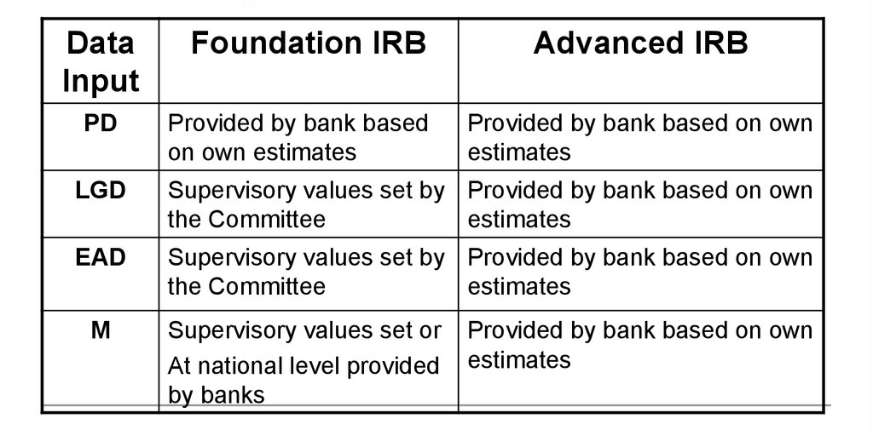
Foundation and Advanced IRB Approach

Slide 13
Credit risk modelling

Slide 14
Credit risk modelling refers to data driven risk models which calculates the chances of a borrower defaults on loan (or credit card).
If a borrower fails to repay loan, how much amount he/she owes at the time of default and how much lender would lose from the outstanding amount.
In other words, we need to build probability of default, loss given default and exposure at default models as per advanced IRB approach under Basel norms.

Slide 15
Data Sources for PD Modelling
Demographic Data : Applicant's age, income, employment status, marital status, no. of years at current address, no. of years at job, postal code.
Existing Relationship : Tenure, number of products, payment performance, previous claims.
Credit Bureau Variables : Default or Delinquency history, Bureau score, Amount of credits, Inquiries etc.

Slide 16
Credit Scoring and Scorecard
Probability of Default model is used to score each customer to assess his/her likelihood of default.
This credit score can be built internally by bank or Bank can use score of credit bureaus.
Credit Bureaus collect individuals' credit information from various banks and sell it in the form of a credit report. They also release credit scores.
In US, FICO score is very popular credit score ranging between 300 and 850.
In India, CIBIL score is used for the same and lie between 300 and 900.

Slide 17
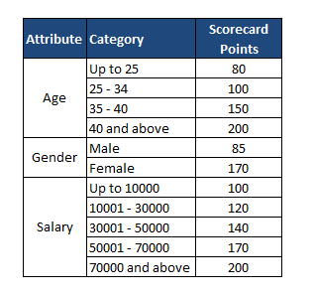
Types of Scorecards
Application Scorecard : It applies to new (first time) customers applying for loan or credit card. It estimate probability of default at time applicant applies for loan.
Suppose cutoff for granting loan = 350 Profile of a New Customer
Age 30
Gender Male
Salary 15000
Total Points = (100 + 85 + 120) = 305 Decision : Refuse Loan

Slide 18
II. Behaviour Scorecard :
It applies to existing customers to assess whether customer will default in loan payment. Performance window is generally 6 to 18 months.
Behavior scorecard is used majorly for the following tasks:
To set credit limit i.e. increase or decrease credit limit
Debt provisioning and profit scoring.
Renewals

Slide 19
Software used in risk analytics
Data Extraction
Most of the data is stored in relational databases (SQL Server, Teradata).
Analyst need to have expert level knowledge of SQL to extract or manipulate data.
Model Building
SAS is the most widely used software in risk analytics.
Despite huge popularity of R and Python these days, more than 90% of banks and other financial institutions still use SAS.
SAS can be easily integrated with relational databases and mainframe.

Slide 20
Thank you

